Slide 1

Agile and Scrum
Agile is a project management and software development approach that promotes flexibility, collaboration, and customer feedback.
Scrum is an Agile framework that organizes work into short, iterative cycles called sprints, enabling teams to deliver value quickly and adapt to changes. It promotes collaboration, transparency, and continuous improvement through defined roles, events, and artifacts.

Slide 2




What is Agile?
Flexibility
Collaboration
Customer Feedback
Incremental Development
Agile embraces change, quickly adapting to new requirements and feedback.
Agile emphasizes constant interaction, promoting a unified approach and shared goals.
Agile incorporates frequent reviews, ensuring the product meets expectations.
Agile breaks projects into manageable increments, delivering tangible functionality.

Slide 3

The Agile Manifesto: Core Values
1
Individuals and interactions
Focus on people and communication over rigid processes.
2
Working software
Prioritize functional software over documentation.
3
Customer collaboration
Engage customers rather than just negotiating contracts.
4
Responding to change
Adapt to changes over sticking to a plan.

Slide 4
Principles Behind the Agile Manifesto
Customer satisfaction
1
Early and continuous delivery.
2
Embrace change
Welcome evolving requirements.
Frequent delivery
3
Deliver working software often.
4
Collaboration
Stakeholders and developers work daily.
Motivated individuals
5
Build projects around them.
6
Face-to-face
Efficient communication.

Slide 5
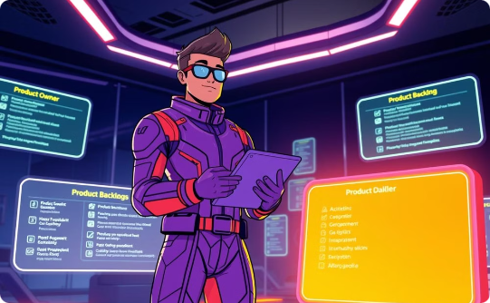


Scrum Framework: Roles
Product Owner
Scrum Master
Development Team
Defines product vision, manages backlog, and prioritizes features to maximize product value.
Facilitates Scrum process, removes obstacles, and coaches the team for optimal performance.
A self-organizing and cross-functional group responsible for delivering working product increments.

Slide 6





Scrum Events: The Scrum Lifecycle
Daily Scrum
Sprint Planning
2
Synchronize and plan daily.
1
Plan work for the Sprint.
Sprint Review
3
Demonstrate completed work.
5
The Sprint
Time-boxed work period.
Sprint Retrospective
4
Reflect and improve.
Scrum events ensure iterative development and continuous improvement. Each event contributes to the overall agility of the project.

Slide 7
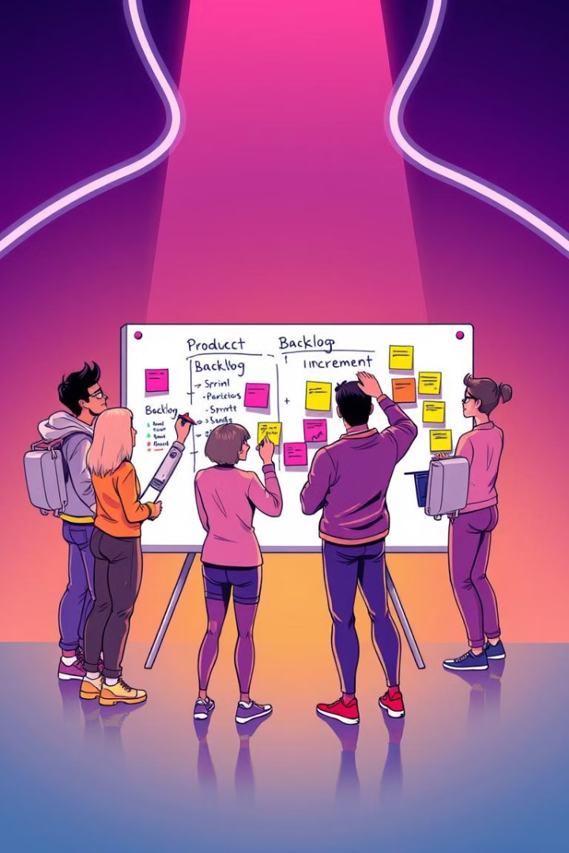



Scrum Artifacts: Tools of the Trade
Product Backlog
A dynamic, prioritized list of features, requirements, enhancements, and fixes that represent the roadmap for product development.
Sprint Backlog
The subset of product backlog items the development team commits to delivering within a single sprint, along with the plan for achieving the sprint goal.
Increment
A tangible, working version of the software that adds value and contributes to the overall product goal upon completion of each sprint.

Slide 8

Quantifiable Benefits of Agile and Scrum
28%
37%
Increase in Project Success
Faster Time to Market
Projects using Agile methodologies experience a 28% higher success rate compared to traditional methods.
Agile teams deliver updates and new features 37% faster, enhancing competitiveness.
15%
24%
Improved Team Collaboration
Enhanced Project Visibility
Teams report a 15% increase in collaboration and communication efficiency with Agile practices.
Stakeholders gain 24% more visibility into project progress and potential roadblocks with Scrum.

